Slide 1
Holiday problems

Slide 2
New vocabulary

Slide 3
Spoiled holiday

Slide 4
Get sunstroke

Slide 5
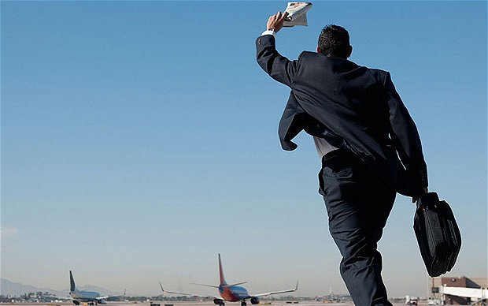
Miss the flight

Slide 6
Get seasick

Slide 7
Car breaks down

Slide 8
To lose passport

Slide 9
Wallet gets stolen

Slide 10
To have a flat tire

Slide 11
to lose the way

Slide 12
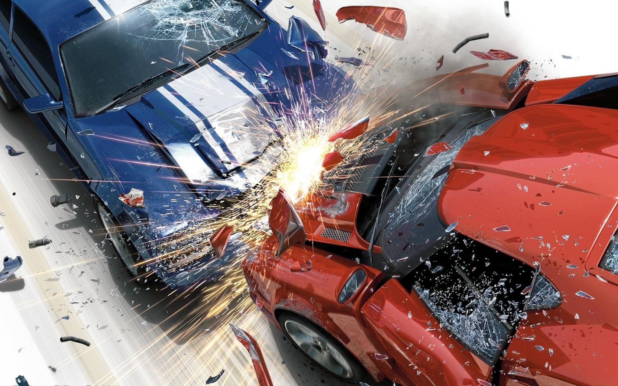
To have an accident

Slide 13
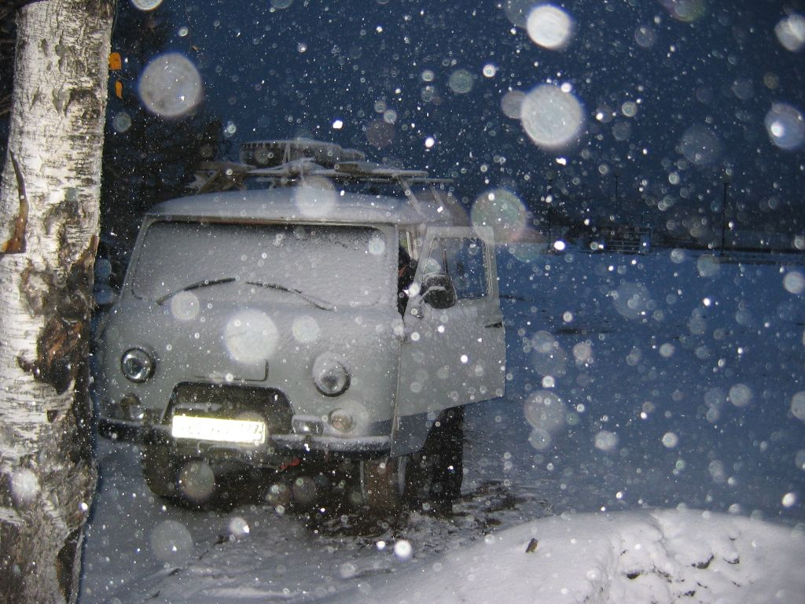
Weather gets bad

Slide 14
feelings

Slide 15
frustrated

Slide 16
confused

Slide 17
relieved

Slide 18
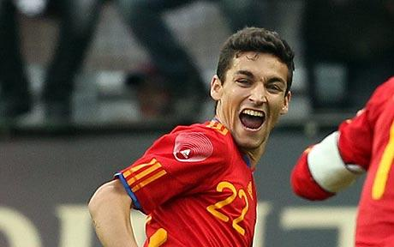
delighted

Slide 19
surprised

Slide 20
irritated

Slide 21
Thank you for your attention!

